Slide 1

HOUSING PRICE PREDICTION
PRESENTED BY

Slide 2
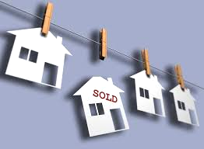
Vision And Mission
Our Vision
Our Mission
Efficiently and accurately predict home sale prices
Create an algorithm that intakes existing dataset and makes accurate prediction on future prices

Slide 3
Agenda
1
3
2
4
PROBLEM & SOLUTION
PROCESSING THE FINDINGS
RESULTS AND FINDINGS
CONCLUDING REMARKS
Notes:
*align fonts

Slide 4

The Problem
Location with the highest property value
Lessening the costs, maximizing profits
?
Features that bring value
Overall, what attributes affect the property value?
Effect of renovations
Notes:
*more inforgraphics

Slide 5
The Solution
Algorithm
Creating a python algorithm that predicts the price of a home depending on its features listed in the dataset
03
Dataset
Collect numerous datasets from different states and clean the data to our specific needs.
02
Analyze The Dataset
Analyzing dataset with over 20k property records to see how the different features of a home can affect its prices
01
Notes:
more infographics

Slide 6

Benefits for Zillow
1
2
3
4
Reliable Estimates
User Specific
Better Interface
Easy To Use
Allows users to create specifications of houses they want
Ensure faster and reliable estimates
Provide a better user friendly interface
Allows users to confidently list their houses or look for houses
Notes:
John

Slide 7
Data Structure and Cleaning
IRRELEVANT DATA
DEDUPLICATE
NULL VALUES
VALIDATION
Removed all the unnecessary data from the dataset
Removed duplicate data to get well balanced results
Removed all the null values and input values where necessary
Final step to authenticate and confirm the data is of high quality
Notes:
Tenzing

Slide 8
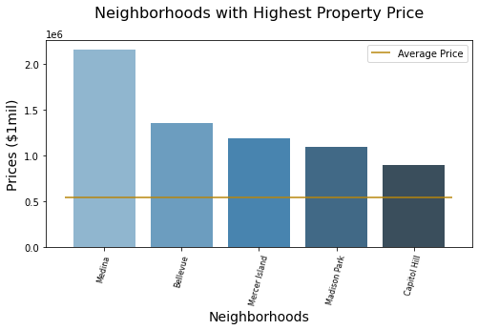
Results and Findings
Average Property Price $530,000
Highest property value in Medina
Lowest property value in Capitol Hill
Notes:
Tenzing

Slide 9
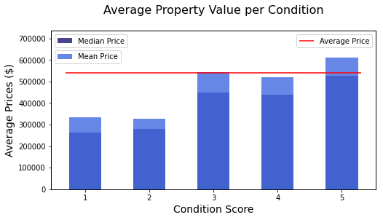
Results and Findings
Property with CS of 1 had a value just over $300,000.
Property with CS of 5 had a value over $600,000.
Difference in value by $300,000.
Notes:
Tenzing

Slide 10
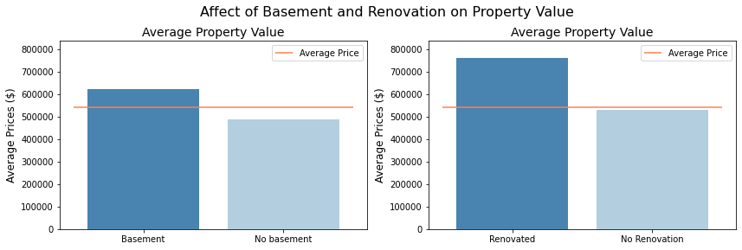
Results and Findings
Property with basement saw an increase in value by $100,000
Property with renovation saw an increase in value by $200,000
Notes:
Tenzing

Slide 11
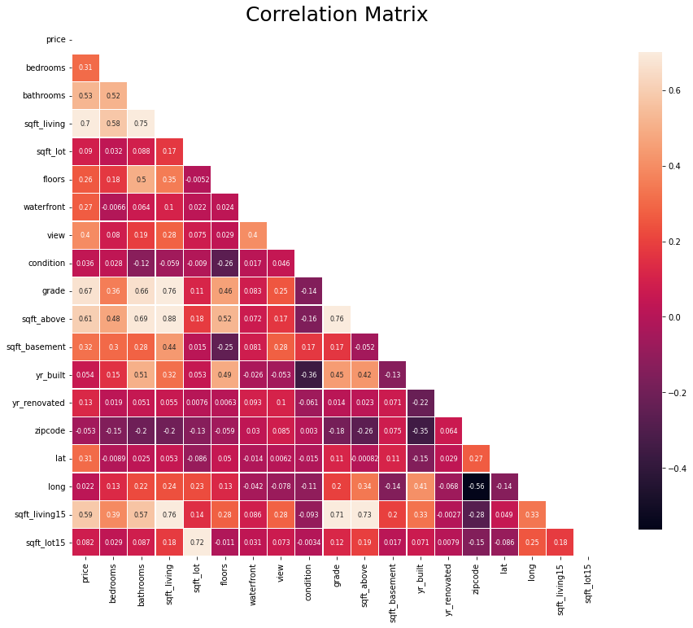
Correlation Matrix
The darker it is, less correlated
Size has a high correlation with price
Condition has a low correlation with all features
Notes:
Kevin

Slide 12
Models and Their Accuracy
Model | MSE | Accuracy Score
Elastic Net | 0.213
Lasso Regression | 0.191
Linear Regression |  | 71.56%
GB Regressor |  | 89.89%

Slide 13
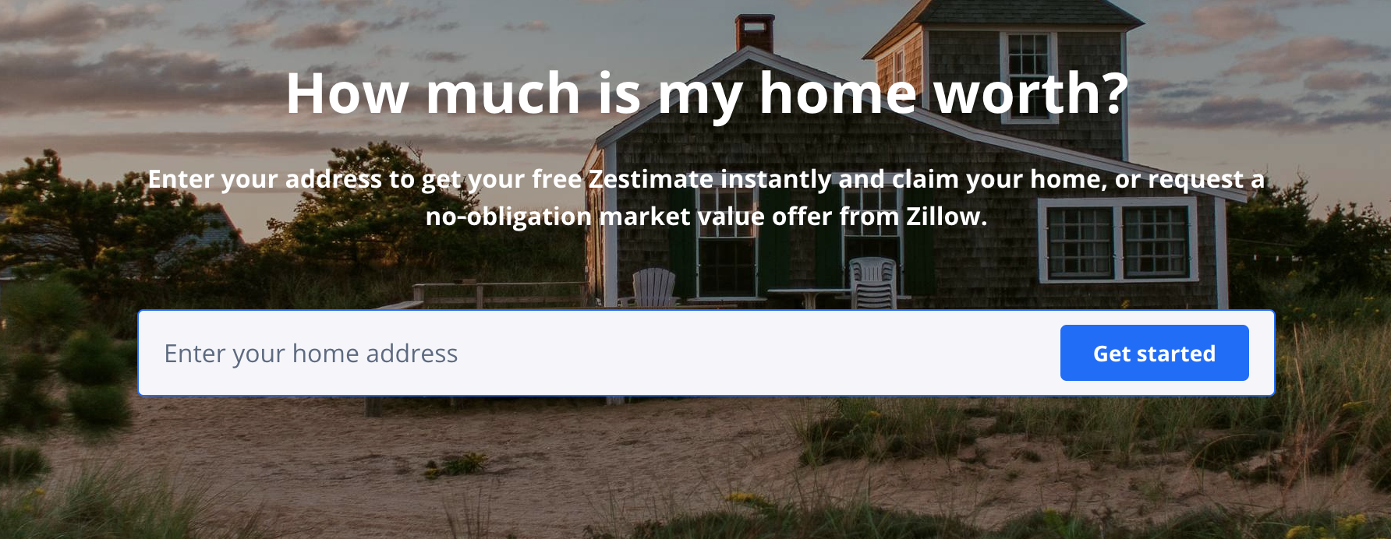
Zestimate
Simple Plug and Play
No way to edit features
Predicts existing house prices
Unable to help in house search
Notes:
bubbles on left instead of text

Slide 14

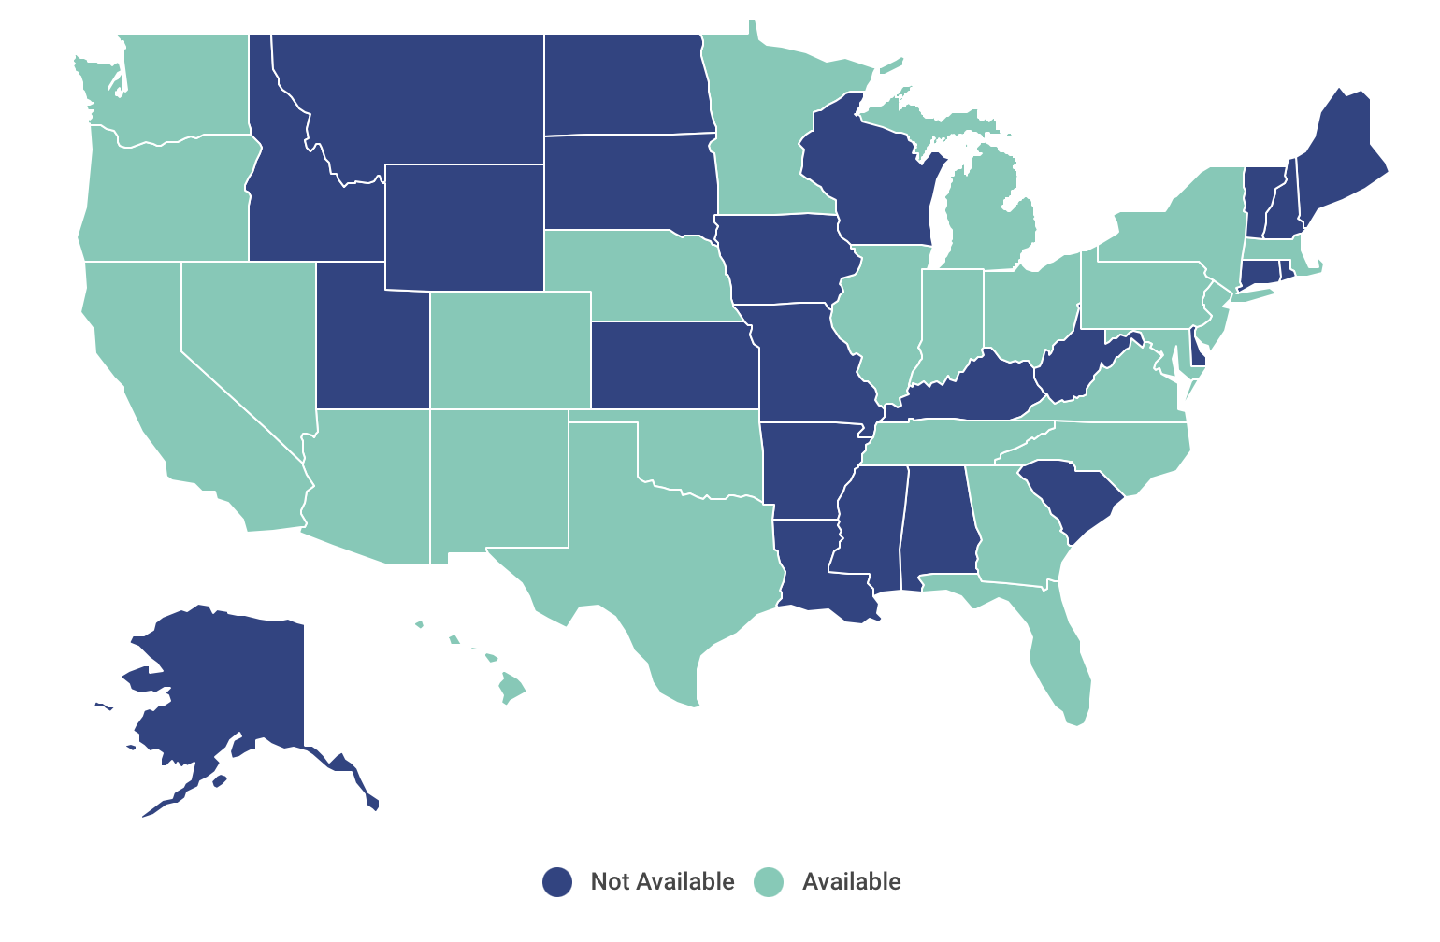
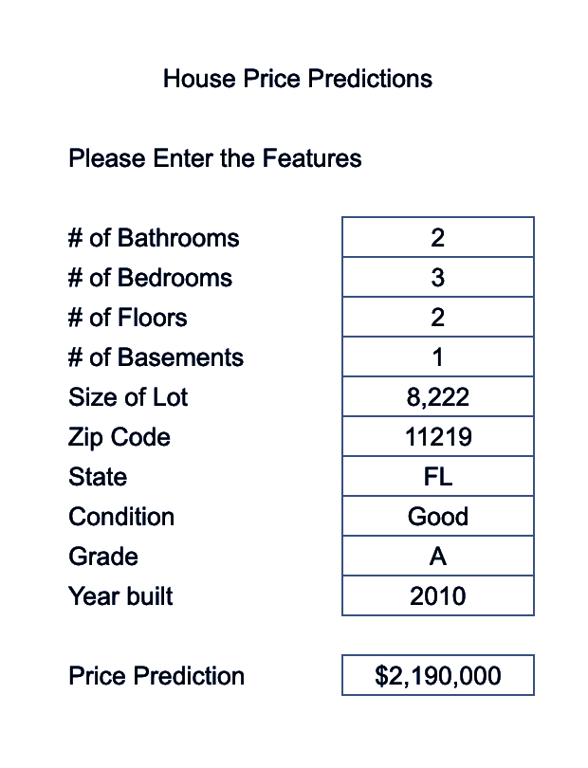
OUR
PRODUCT
Simple User Interface
Allows users to imagine their home
Accurate estimations based on the user inputs
Available in 27 States
$$$
BUY THE APP FOR | $900,000

Slide 15
Our Goals
Increased Accuracy
Refined App
Available In All 50 States
AUGUST 2022
OCTOBER 2022
JANUARY 2023
More fine tuning to pass a 90% Accuracy
Shows real time changes to predictions and more app functions
Add and update program to offer the product throughout the nation

Slide 16

Thank You

Slide 17
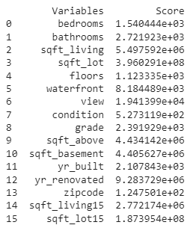
APPENDIX

Slide 18
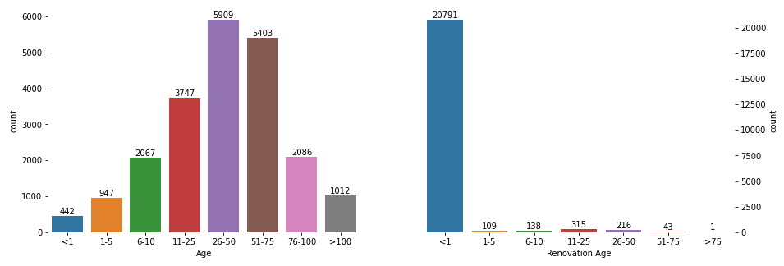
APPENDIX cont.

